Slide 1
Step One 2013-2014
Family, Career & Community Leaders of America

Slide 2
FCCLA
Family, Career & Community Leaders of America

Slide 3
Food Fact
FCCLA stands for the Family, Career and Community Leaders of America.

Slide 4
National Outreach Project

Slide 5
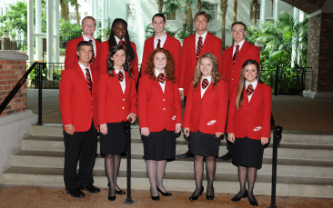
National Officers
There are 10 National Officers elected from high school students across the country each year.

Slide 6
National Leadership Conference
2013: Nashville, TN
THIS YEAR, 2014:
San Antonio, TX

Slide 7
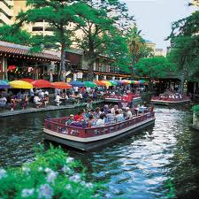
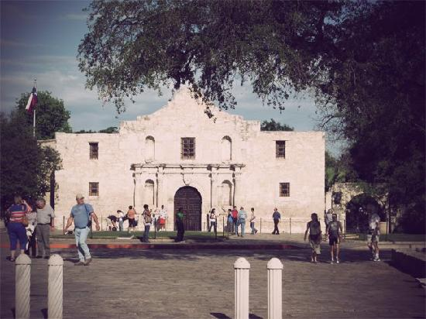
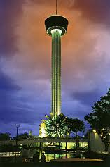
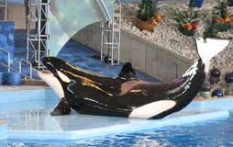
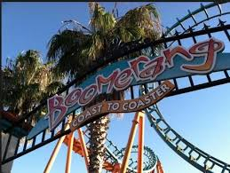
4. Where is the next National Leadership Conference? Share four highlights about the city?
San Antonio, Texas July 6th – 10th 2014
Sea World & Six Flags !!!
Famous River Walk area full of shops, restaurants & river boat rides.
Site of the Alamo!
Tower of America

Slide 8
The NATIONAL PROGRAMS
There are 7 national programs– Families First, FACTS—Families Acting for Community Traffic Safety, Financial Fitness, Career Connection, Power of One, Student Body, STOP the Violence
You can complete these programs individually, as a chapter or in class.
Many programs have cash awards for individuals and school programs!

Slide 9
Families First
Help youth become strong family members and leaders for today and tomorrow.
2. Strengthen the family as the basic unit of society.

Slide 10
FACTS
Families Acting for Community Traffic Safety
No Texting and Driving Campaigns
Bike Safety
Anti-drunk driving campaigns
Grad Night, Safe Night pledge

Slide 11
Financial Fitness
FCCLA national peer education program that teaches youth how to make, save and spend money wisely.
Learn to become a wise financial manager and smart consumer.

Slide 12
Power of One
Helps students find and use their personal power.
Members set goals, work to achieve them and enjoy the results.
Each Unit must be completed to earn the award:
1. A Better You
2. Family Ties
3. Working on Working
4. Take the Lead
5. Speak Out for FCCLA

Slide 13
Student Body
National program that helps young people learn to make informed, responsible decisions about their health.
1. Eat Right!
2. Be Fit!
3. Make Healthy Choices!

Slide 14
Career Connection
National program that guides youth to link their options and skills for success.
Discover your strengths
Target career goals
Initiate a plan to achieve

Slide 15
STAR Events—FCCLA’s competitive program
Students Taking Action with Recognition
31 Competitive Events for every interest!

Slide 16
STAR Events (Competition)
WHY? To get experience planning and carrying out a project of your choice, and receive recognitions for doing it!
WHERE? Regionals is at the beginning of February at WSU.
HOW? Talk to Mrs. Parry for details on how to get started!

Slide 17
STAR Events continued…
Entrepreneurship (Mrs. Milburn got 100% at Nationals)
Environmental Ambassador
Fashion Construction
Fashion Design
Focus on Children
ONLINE EVENTS
Digital Stories for Change
FCCLA Chapter Website
No Kid Hungry National Outreach Project
Virtual Poster
Advocacy
Applied Technology
Applied Math for Culinary Management
Career Investigation
Chapter Service Project
Chapter Showcase
Culinary Arts
Early Childhood

Slide 18
STAR Events categories
Life Event Planning
National Programs in Action
Nutrition and Wellness
Parliamentary Procedure
Promote and Publicize FCCLA!
Recycle and Redesign
Sports Nutrition
Teach and Train
Food Innovations
Hospitality, Recreation and Tourism
Illustrated Talk
Interior Design
Interpersonal Communications
Job Interview
Leadership

Slide 19
STOP the Violence
Students
Taking
On
Prevention
This National Program is adaptable to the needs of your community. Think of projects to make homes, schools and communities safer places to be for everyone.

Slide 20
FCCLA Membership Campaign is called…
Be Part of It!
Recruit
Retain
Recognize

Slide 21
Members & Chapters
200,000 members
Nearly 6,500 chapters

Slide 22
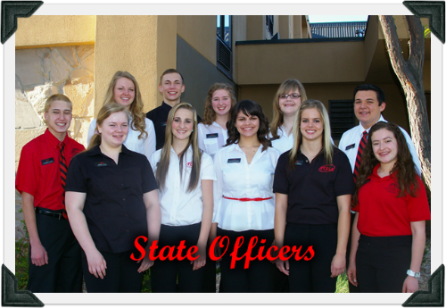
Utah Membership
Current number of members: 3,000
11 State Officers
STATE THEME:
“Adventure is
Out There!”

Slide 23
National FCCLA Magazine
Teen
Times
Yours free when you join!

Slide 24
National FCCLA Week
February 9-15, 2014

Slide 25
Membership Privileges:
Copy of quarterly Teen Times
Access to trips, conferences and members-only activities
Resumé-building activities like community service opportunities, leadership skills
Extra credit in Mrs. Parry’s, Hudman’s and Bruce’s classes
Meetings that involve food
Make new friends and help plan the activities

Slide 26
State Fall Leadership
Sept. 24-25, 2013
Provo, UT

Slide 27
Our first meeting is Wednesday, September 11th.
2nd half of lunch join
Ice Cream Social
In Mrs. Parry’s room 1

Slide 28
USU Day
Pay due’s by the 12th & you can go on the fieldtrip ($15)
Fun leadership training
Learn about FCCLA
Fashion show & design

Slide 29
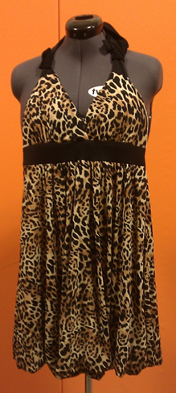
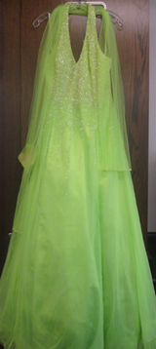
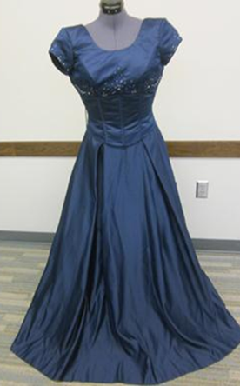
Homecoming Dress Sale $5-50 See dresses after school in room 1

